Slide 1

Decentralized Energy Trading Model with Smart Grids and Blockchain
Authors
Jaymin Dafda Shriniwas Patil Keyur Parmar
SVNIT SVNIT SVNIT

Slide 2
Outline
Introduction
Literature Survey
The Proposed Decentralized Energy Trading Model
Results and Analysis
Conclusions

Slide 3
Decentralized Energy Trading Model with Smart Grids and Blockchain

Slide 4
Introduction

Slide 5
What is Energy Trading?

Slide 6
Energy Generation and Distribution
Energy Generation Sources [1]
Renewable - 26%
Non-renewable - 74%
Energy Lost during Distribution [1]
Distribution - 5%
Generation - 59%
[1] International Energy Agency. IEA data and statistics for energy consumption [Online]. Available: https://www.iea.org/data-andstatistics/data-tables?country=WORLDenergy=Balancesyear=2018. Accessed: June 15, 2022.

Slide 7
How can we minimize energy loss?
Efficient and reliable energy generation and distribution

Slide 8
How can we provide efficient and reliable energy distribution?
Smart Grids [9]
[9] M. Nazari, S. Khorsandi and J. Babaki, “Security and Privacy Smart Contract Architecture for Energy Trading based on Blockchains”, Proceedings of ICEE: 29th Iranian Conference on Electrical Engineering, Iran, IEEE, 2021 pp. 596-600, 10.1109/ICEE52715.2021.9544155.

Slide 9
Energy Trading
When energy demand exceeds supply, energy trading enters scene

Slide 10
Who Trades Energy?

Slide 11
Who Trades Energy?
Producer
Consumer
Prosumer
Note: Cochin Airport (CIAL) is positive-powered.

Slide 12
Literature Survey

Slide 13
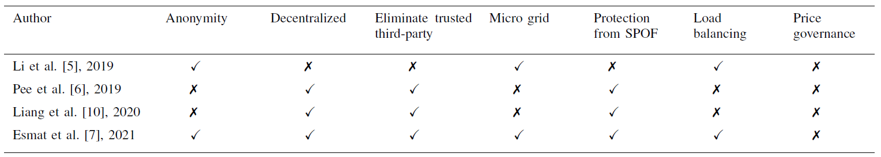
State-of-the-Art Comparison between the Existing Models

Slide 14
Challenges in Existing Mechanisms
Transparency for users to gain trust
Load balancing of multiple transaction
Insider threat from a trusted third-party
Centralized systems are vulnerable to SPOF

Slide 15
What are the solutions?
Blockchain

Slide 16
Can blockchain and price governance provides solutions for above challenges?
Yes,
Blockchain to eliminate TTP and SPOF, and provide transparency

Slide 17
The Proposed Decentralized Energy Trading Model

Slide 18
Proposed Decentralized Energy Trading Model
Entities
Producer
Consumer
Prosumer
Trading Market Center (TMC)
Blockchain Netwok

Slide 19
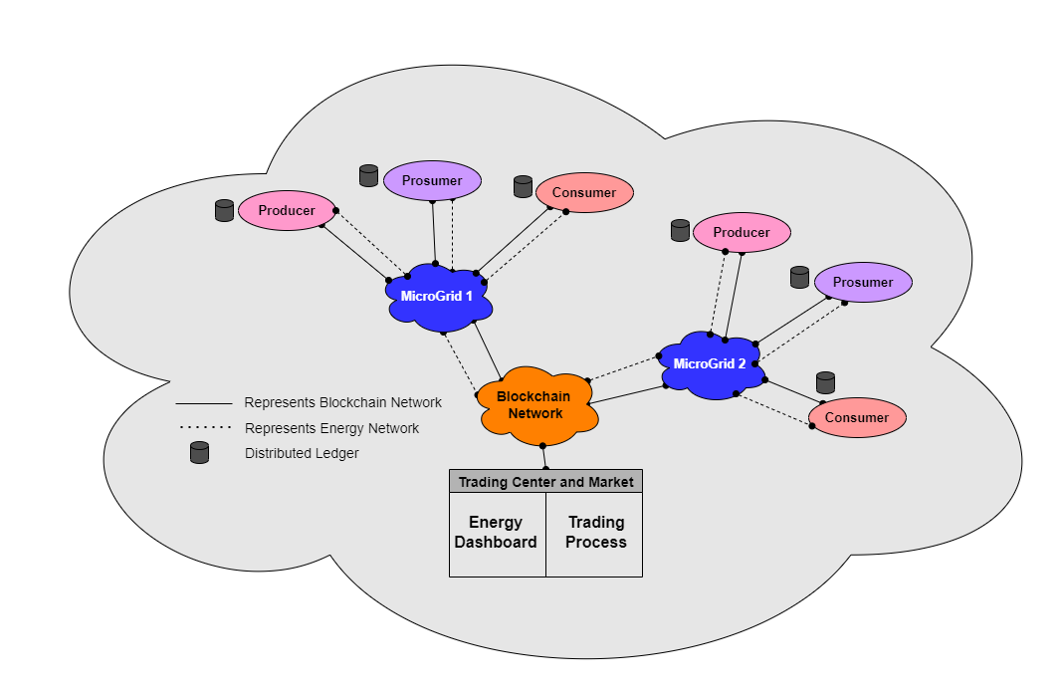
Architecture of the Proposed Decentralized Energy Trading Model

Slide 20
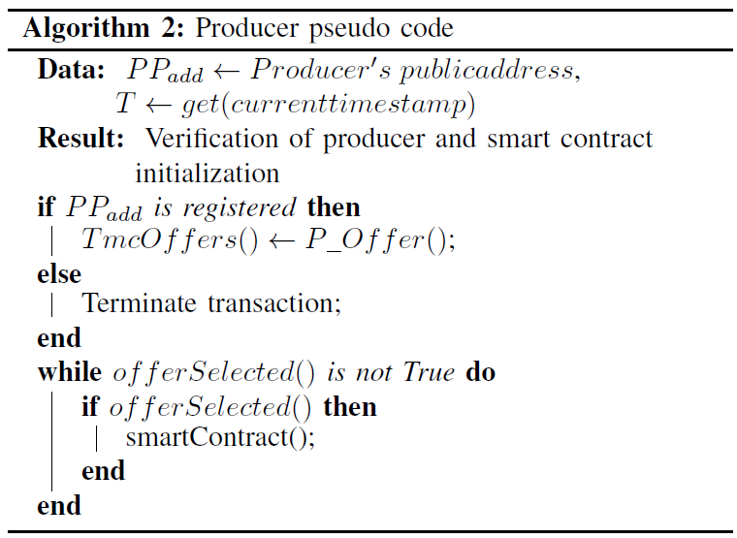
Producer Algorithm

Slide 21
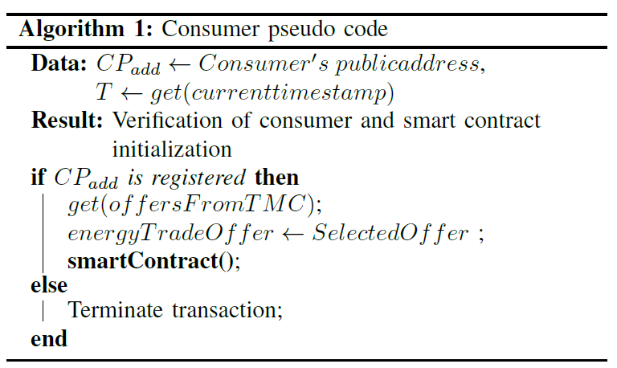
Consumer Algorithm

Slide 22
Smart Contract Algorithm
Continued on next page…

Slide 23
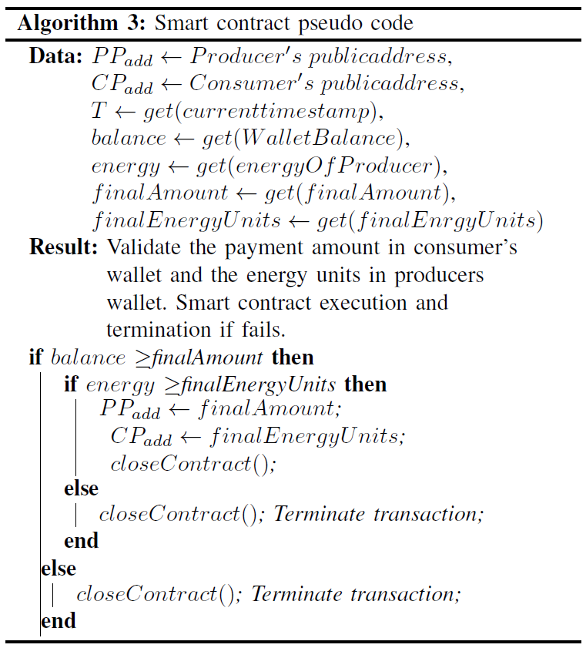

Slide 24
Results and Analysis

Slide 25
Implementation Methodology
RSA for public-private key generation
Keccak Hash Function to generate public address on ethereum (20 byte)
Remix IDE for smart contract development

Slide 26
Security and Privacy
Producers and consumers - Instead of real identities use public keys (addresses)
Blockchain - Provides immutability of records and transperancy
Smart contract enables automatic energy trading

Slide 27
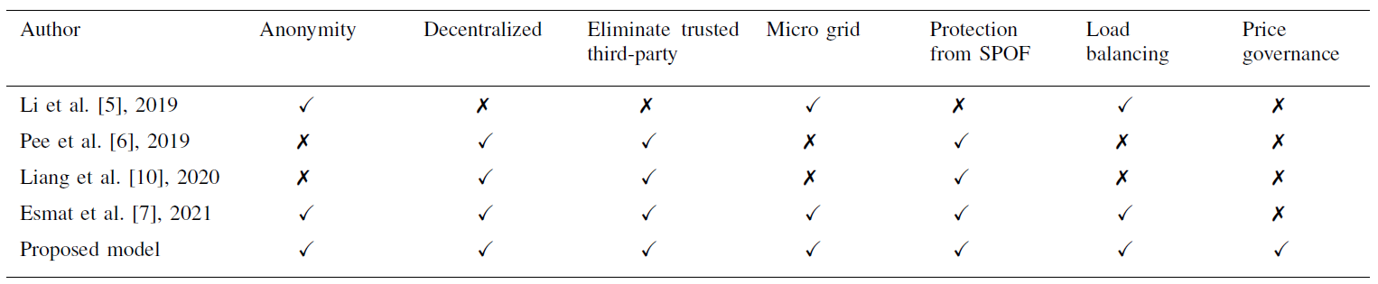
State-of-the-art comparison between proposed decentralized energy trading model and the existing models

Slide 28
Conclusions

Slide 29
Conclusions
Proposed a model for the management of energy trading
Used blockchain to eliminate centralized management
Provides a transparency in the energy trading management
Ensures security and privacy of users (producers and consumers)
Ensures users will get correct price

Slide 30
References

Slide 31
[1] International Energy Agency. IEA data and statistics for energy consumption [Online]. Available: https://www.iea.org/data-andstatistics/data-tables?country=WORLDenergy=Balancesyear=2018. Accessed: June 15, 2022.
[2] International Energy Agency. (2021) Net Zero by 2050 [Online]. Available: https://www.iea.org/articles/net-zero-by-2050. Accessed: June 15, 2022.
[3] N. Z. Aitzhan and D. Svetinovic, “Security and Privacy in Decentralized Energy Trading Through Multi-Signatures, Blockchain and Anonymous Messaging Streams.”, Transactions on Dependable and Secure Computing, vol. 15, no. 5, pp. 840-852, IEEE, 2018, 10.1109/TDSC.2016.2616861.
[4] Suleiman, H., Svetinovic, D. “Evaluating the effectiveness of the security quality requirements engineering (SQUARE) method: a case study using smart grid advanced metering infrastructure.”, Requirements Eng. Volume 18, Issue 4, 251–279, 2013, 10.1007/s00766-012-0153-4.
[5] T. Li, W. Zhang, N. Chen, M. Qian and Y. Xu, “Blockchain Technology Based Decentralized Energy Trading for Multiple-Microgrid Systems”, Proceedings of EI2: 3rd Conference on Energy Internet and Energy System Integration, Changsha, China, IEEE, 2019, pp. 631-636, 10.1109/EI247390.2019.9061928.
[6] S. J. Pee, E. S. Kang, J. G. Song and J. W. Jang, “Blockchain based smart energy trading platform using smart contract”, Proceedings of International Conference on Artificial Intelligence in Information and Communication (ICAIIC), Okinawa, Japan, pp. 322-325, IEEE, 2019, 10.1109/ICAIIC.2019.8668978.
[7] Ayman Esmat, Martijn de Vos, Yashar Ghiassi-Farrokhfal, Peter Palensky, Dick Epema. “A novel decentralized platform for peer-to-peer energy trading market with blockchain technology”, Applied Energy. Volume 282. Part A. 2021, 10.1016/j.apenergy.2020.116123.
[8] P. Ganguly, M. Nasipuri and S. Dutta, “Challenges of the Existing Security Measures Deployed in the Smart Grid Framework”, Proceedings of SEGE: 7th International Conference on Smart Energy Grid Engineering, Oshawa, Canada, pp. 1-5, IEEE, 2019, 10.1109/SEGE.2019.8859917.
[9] M. Nazari, S. Khorsandi and J. Babaki, “Security and Privacy Smart Contract Architecture for Energy Trading based on Blockchains”, Proceedings of ICEE: 29th Iranian Conference on Electrical Engineering, Iran, IEEE, 2021 pp. 596-600, 10.1109/ICEE52715.2021.9544155.
[10] M. -T. Chen, C. X. Liang and C. C. Chen, “A Traceable Smart Grid Trading System under Blockchain”, International Symposium on Computer, Consumer and Control (IS3C), Taichung, Taiwan, pp. 380-383, IEEE, 2020, 10.1109/IS3C50286.2020.00104.

Slide 32
[11] E. S. Kang, S. J. Pee, J. G. Song and J. W. Jang, “A Blockchain-Based Energy Trading Platform for Smart Homes in a Microgrid”, Proceedings of ICCCS: 3rd International Conference on Computer and Communication Systems, Nagoya, Japan, pp. 472-476, IEEE, 2018, 10.1109/CCOMS.2018.8463317.
[12] Investopedia. Equilibrium. Retrived from https://www.investopedia.com/terms/e/equilibrium.asp. Accessed: June 15, 2022.
[13] H. Farhangi, “The path of the smart grid”, Power and Energy Magazine, vol. 8, no. 1, pp. 18-28, IEEE, 2010, 10.1109/MPE.2009.934876.
[14] M. Lehtonen, A. Seppala, V. Kekkonen, P. Koponen, G. Koreneff and B. Lemstrom, “Distribution energy management in the environment of deregulated electricity market”, Proceedings of International Conference on Energy Management and Power Delivery EMPD, Singapore, pp. 516-521 vol.2, IEEE, 1995, 10.1109/EMPD.1995.500781.
[15] G. Suter and T. G. Werner, “The distribution control centre in a SmartGrid”, Proceedings of CIRED - 20th International Conference and Exhibition on Electricity Distribution - Part 1, Prague, Czech Republic, pp. 1-4, IET, 2009, 10.1049/cp.2009.0521.
[16] J. Kang, R. Yu, X. Huang, S. Maharjan, Y. Zhang and E. Hossain, “Enabling Localized Peer-to-Peer Electricity Trading Among Plug-in Hybrid Electric Vehicles Using Consortium Blockchains”, Transactions on Industrial Informatics, vol. 13, no. 6, pp. 3154-3164, IEEE, 2017, 10.1109/TII.2017.2709784.
[17] Team KECCAK. KECCAK hash function [Online]. Available: https://keccak.team/keccak.html. Accessed: June 15, 2022.
[18] Ethereum GitHub. Yellow Paper. Retriven from https://ethereum.github.io/yellowpaper/paper.pdf. Accessed: 2022-06-20.
[19] S. Maharjan, Q. Zhu, Y. Zhang, S. Gjessing and T. Basar, “Dependable Demand Response Management in the Smart Grid: A Stackelberg Game Approach”, Transactions on Smart Grid, vol. 4, no. 1, pp. 120-132, IEEE, 2013, 10.1109/TSG.2012.2223766.

Slide 33
Thank You

Slide 35
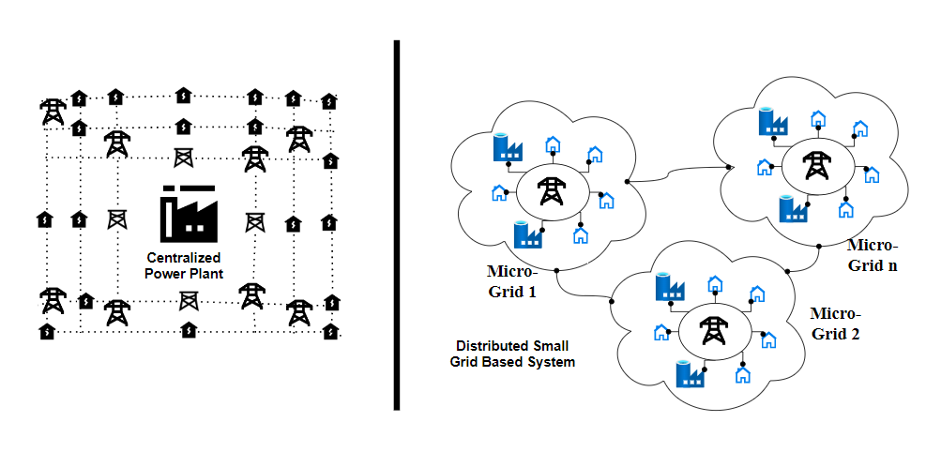
Centralized Vs Decentralized Architecture

